Slide 1
Analysis And Summarization Of H1B Visa Applicants Presented By, Shreyas Sunil Purohit

Slide 2
What is Big Data?
Data with a Huge Size
Big data is the term for collection of data sets– structured, unstructured and semi-structured.
Its so large and complex that it becomes difficult to process using on-hand database system tools
Big data can be analyzed for insights that lead to better decisions and strategic business moves.

Slide 3



Examples Of Big Data
The New York Stock Exchange generates
about one terabyte of new trade data per day
Statistic shows that 500+terabytes of new data gets
Ingested into the databases of social media site Facebook
Single Jet engine can generate 10+terabytes of data in 30
minutes of a flight time. And this reaches up to many Petabytes.

Slide 4
Categories Of 'Big Data'
Structured :- Any data that can be stored, accessed and processed in the form of fixed format is termed as a 'structured' data
Unstructured:- Any data with unknown form or the structure is classified as unstructured data.
Semi-structured:- Semi-structured data can contain both the forms of data. We can see semi-structured data as a strucutured in form but it is actually not defined with e.g. a table definition in relational DBMS.

Slide 5
Characteristics Of 'Big Data'
Volume :- The name 'Big Data' itself is related to a size which is enormous. Size of data plays very crucial role in determining value out of data.
Variety :- Variety refers to heterogeneous sources and the nature of data, both structured and unstructured.
Velocity :- The term velocity refers to the speed of generation of data. How fast the data is generated and processed.
Veracity :- Defines uncertainty and inconsistencies in the data.
Value:- Defines useful data. Mechanism to bring the correct meaning out of the data.
Variability:- Defines process of being able to handle and manage the data effectively.

Slide 6
What Comes Under Big Data?
Black Box Data
Social Media Data
Stock Exchange Data
Power Grid Data
Transport Data
Search Engine Data

Slide 7
Benefits of Big Data Processing
Businesses can utilize outside intelligence while taking decisions.
Improved customer service.
Early identification of risk to the product/services, if any.
Better operational efficiency.
Cost effective storage system for huge data sets.

Slide 8
Big Data Challenges
Capturing data
Curation
Storage
Searching
Sharing
Transfer
Analysis
Presentation

Slide 9
HADOOP
Apache HADOOP is an Open-Source framework used to develop data processing applications which are executed in a distributed computing environment.
Allows to store and process large data sets in parallel and distributed fashion.
Storing data and running applications on clusters of commodity hardware.
It provides massive storage for any kind of data, enormous processing power and the ability to handle virtually limitless concurrent tasks or jobs.
Designed to scale up from single server to thousands of machines, each offering local computation and storage.

Slide 10
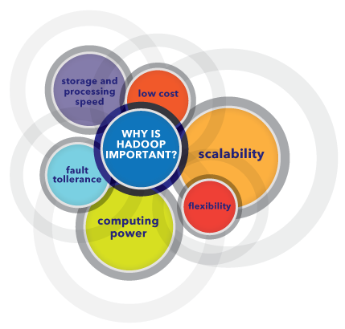
Why is Hadoop important?

Slide 11
What are the challenges of using Hadoop?
Map-Reduce programming is not a good match for all problems
There’s a widely acknowledged talent gap
Data security
Full-fledged data management and governance

Slide 12
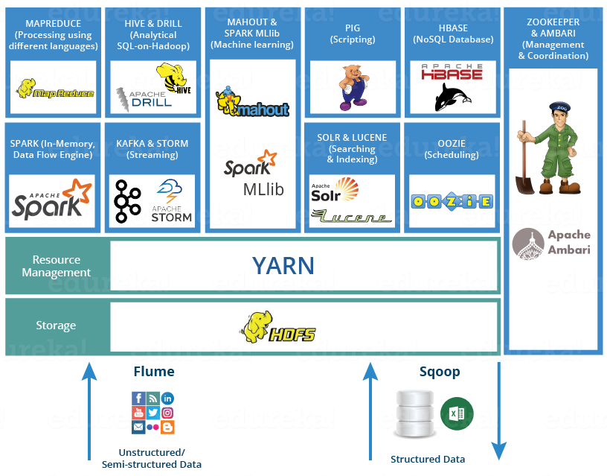
Components of Hadoop

Slide 13
HDFS
Hadoop comes with a distributed file system called HDFS (HADOOP Distributed File Systems)
HADOOP based applications make use of HDFS.
HDFS is designed for storing very large data files, running on clusters of commodity hardware
It is fault tolerant, scalable, and extremely simple to expand.

Slide 14
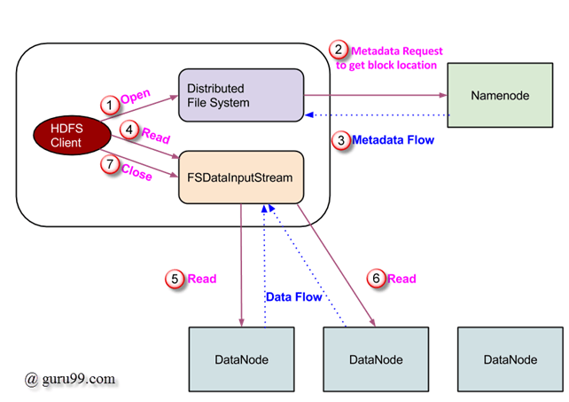
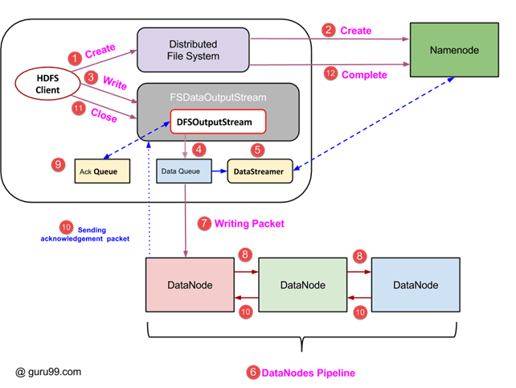
Operations in HDFS (Read and Write)
Read Operation
Write Operation

Slide 15
MAPREDUCE
MapReduce is a programming model suitable for processing of huge data.
Hadoop is capable of running MapReduce programs written in various languages: Java, Ruby, Python, and C++.
MapReduce programs are parallel in nature, thus are very useful for performing large-scale data analysis using multiple machines in the cluster.
MapReduce programs work in two phases:
Map phase
Reduce phase.

Slide 16
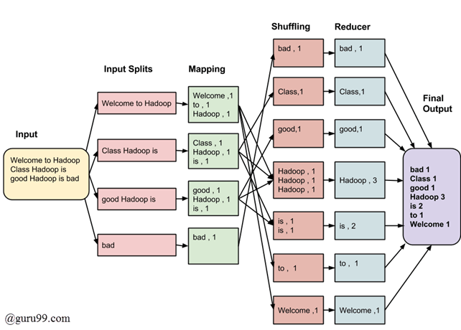
How MapReduce works

Slide 17
Hive
It is a data warehouse framework for querying and analysis of data that is stored in HDFS. Hive is an open source-software that lets programmers analyze large data sets on Hadoop.
Hive provides SQL-like declarative language, called HiveQL, which is used for expressing queries.
Hive engine compiles these queries into Map-Reduce jobs to be executed on Hadoop.
It has a support for simple SQL like functions- CONCAT, SUBSTR, ROUND etc., and aggregation functions- SUM, COUNT, MAX etc. It also supports GROUP BY and SORT BY clauses.

Slide 18
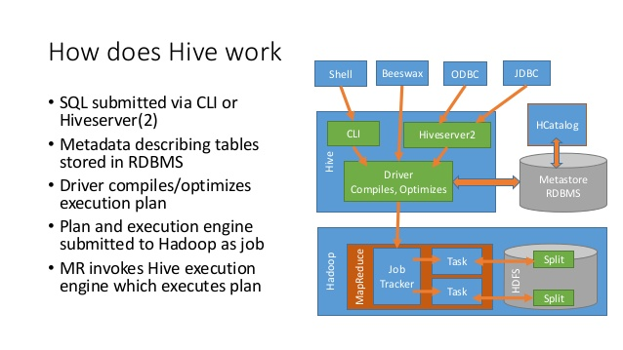
How HIVE Works

Slide 19
PIG
Pig is a high level programming language useful for analyzing large data sets.
Pig enables people to focus more on analyzing bulk data sets and to spend less time in writing Map-Reduce programs.
Pig programming language is designed to work upon any kind of data.
Pig consists of two components:
Pig Latin, which is a language
Runtime environment, for running PigLatin programs.

Slide 20
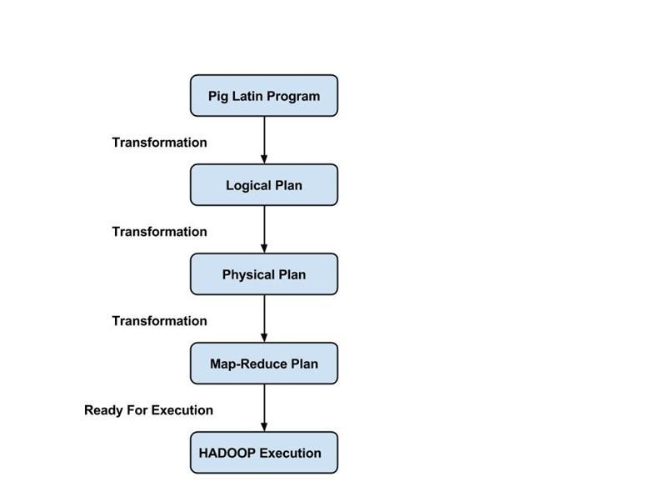
How PIG Works
PigLatin uses familiar keywords from data processing e.g., Join, Group and Filter.

Slide 21
Sqoop
Apache Sqoop (SQL-to-Hadoop) is designed to support bulk import of data into HDFS from structured data stores such as relational databases, enterprise data warehouses, and NoSQL systems.
Sqoop is based upon a connector architecture which supports plugins to provide connectivity to new external systems.
Data transfer between Sqoop and external storage system is made possible with the help of Sqoop's connectors.
Sqoop provides optimized MySQL and PostgreSQL connectors that use database-specific APIs to perform bulk transfers efficiently.

Slide 22
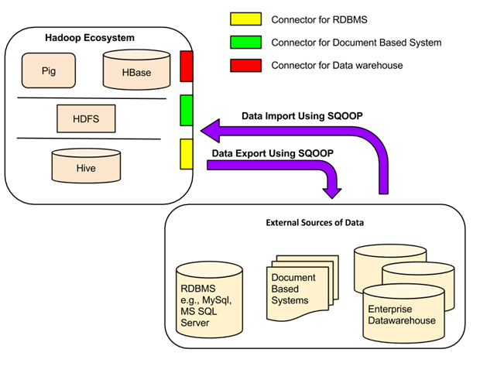
How SQOOP Works

Slide 23
FLUME
Apache Flume is a system used for moving massive quantities of streaming data into HDFS.
Collecting log data present in log files from web servers and aggregating it in HDFS for analysis, is one common example use case of Flume.
Flume supports multiple sources like –
'tail' (which pipes data from local file and write into HDFS via Flume, similar to Unix command 'tail')
System logs
Apache log4j (enable Java applications to write events to files in HDFS via Flume).

Slide 24
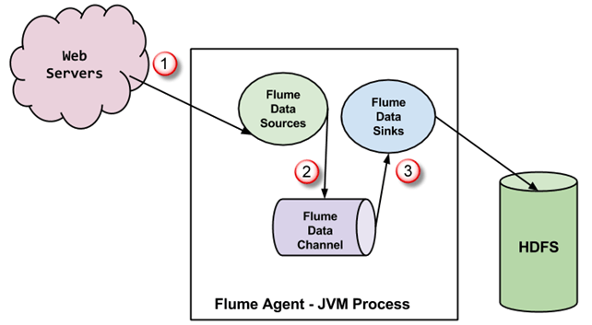
Data Flow in Flume
A Flume agent is a JVM process which has 3 components -Flume Source, Flume Channel and Flume Sink- through which events propagate after initiated at an external source .

Slide 25
HBASE
HBase is an open source, distributed NOSQL database.
Initially, it was Google Big Table, afterwards it was re-named as HBase and is primarily written in Java.
HBase can store massive amounts of data from terabytes to petabytes
A table for a popular web application may consist of billions of rows. If we want to search particular row from such huge amount of data, HBase is the ideal choice as query fetch time in less.

Slide 26
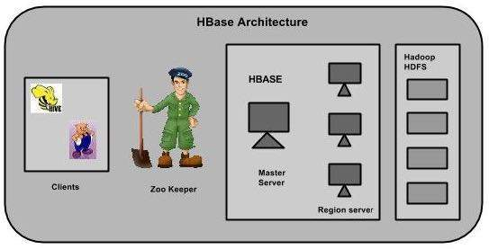
How HBASE Works

Slide 27
Project Objective
The H1B is an employment-based, non-immigrant visa category for temporary foreign workers in the United States. For a foreign national to apply for H1B visa, an US employer must offer a job and petition for H1B visa with the US immigration department. This is the most common visa status applied for and held by international students once they complete college/ higher education (Masters, Ph.D.) and work in a full-time position.
Various Technologies like MapReduce, Pig and Hive are used to perform operations on these data and the values are yielded.

